Slide 1

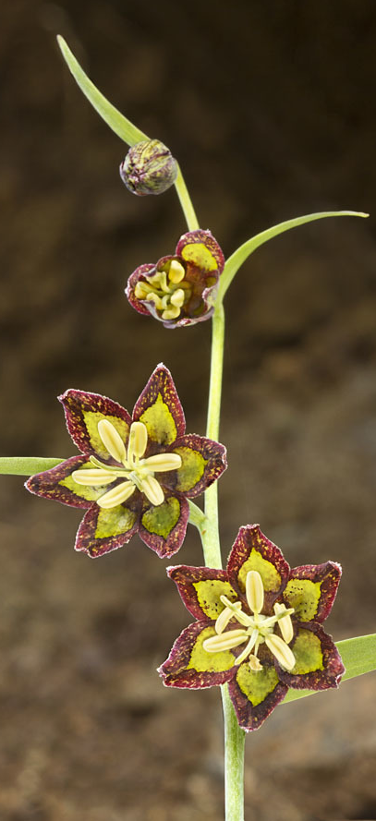
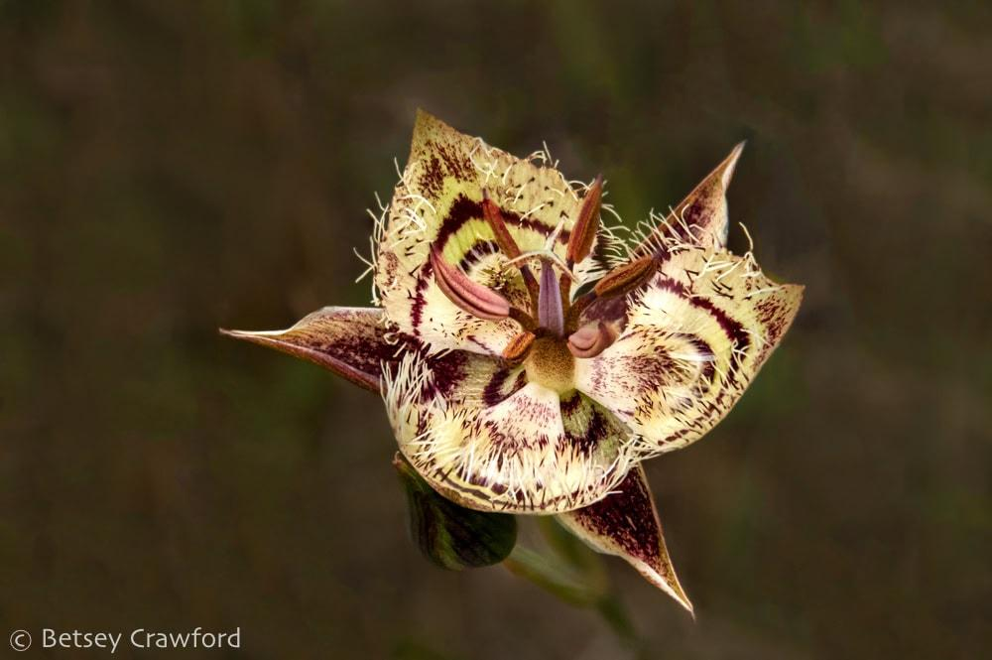
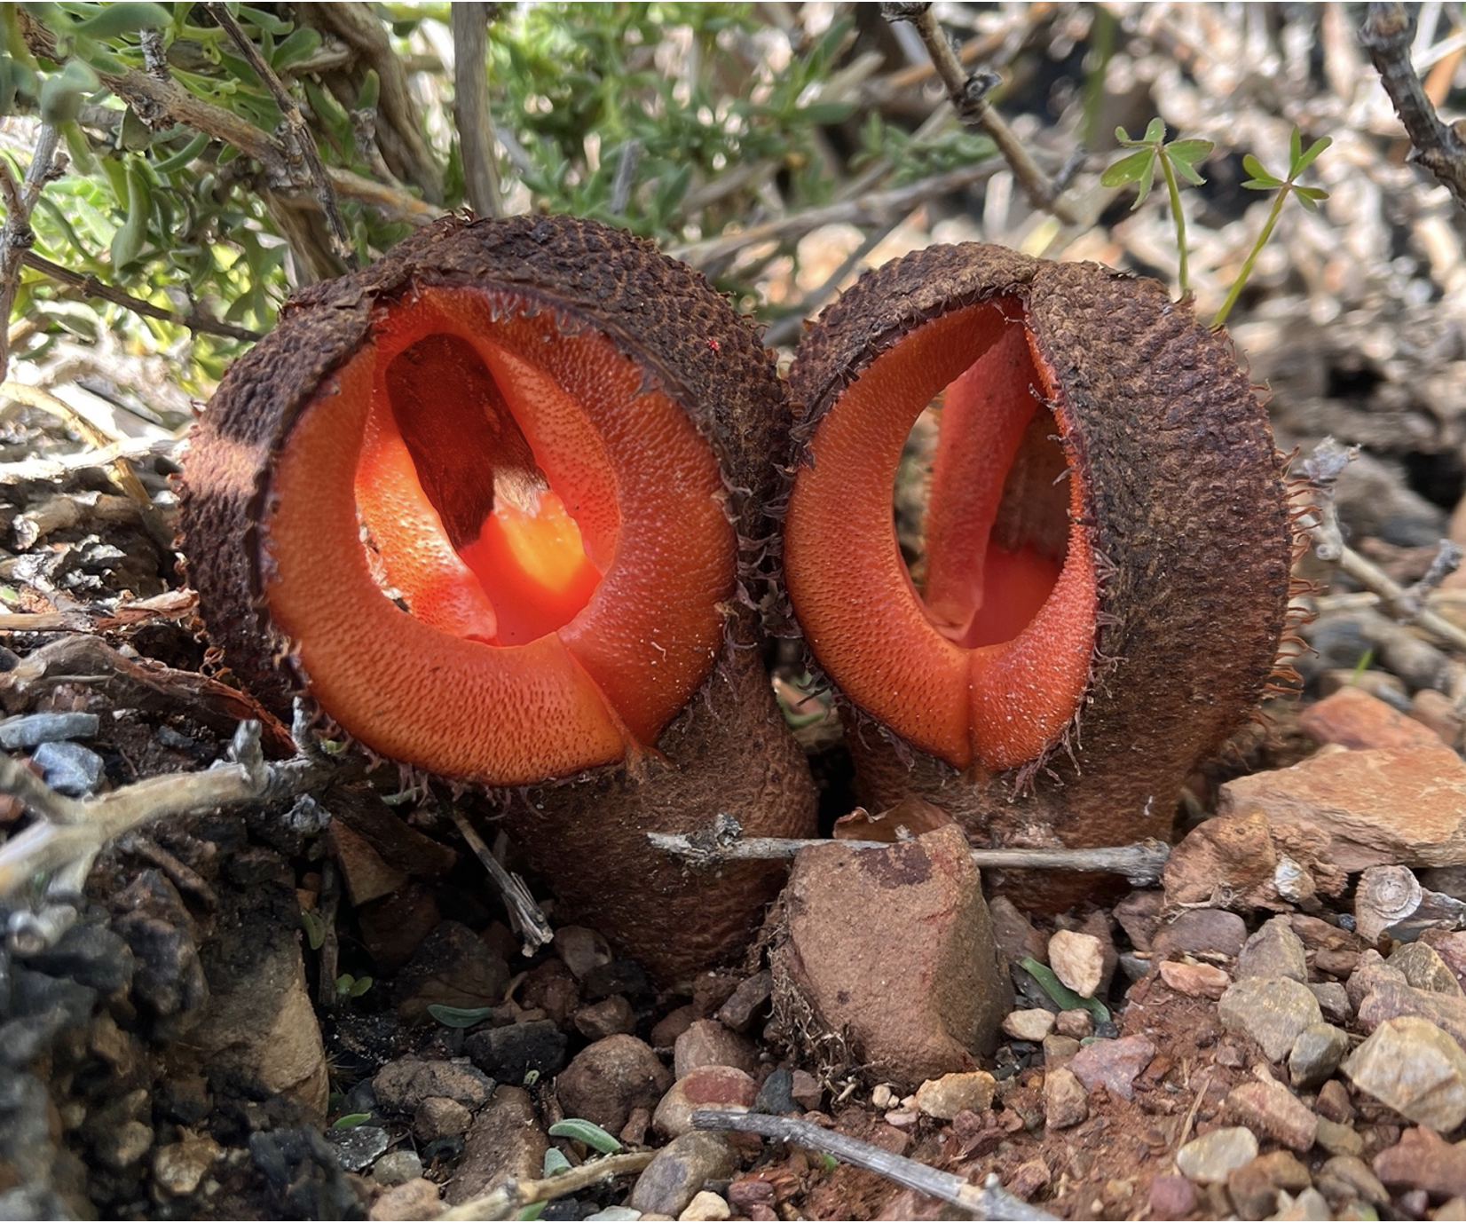
‘popbio’
Blennosperma bakeri
Sadie Armstrong, Anissa Stull, Priscilla Ta, Emma Tao
February 13, 2025
Calochortus tiburonensis
Hydnora africana
Fritillaria ojaiensis
Notes:
Provide the name of the package, presenters’ names, and date.
Feel free to add photos, figures, and text as needed.

Slide 2
What does the package do?
Build and analyze projection matrices from census data classified by age or stage
Estimate vital rates
Calculate population growth and extinction rates
Project population growth and extinction
Notes:
Don’t reinvent the wheel. Most packages have descriptions on the Comprehensive R Archive Network. Copy, paste, cite.
You may also want to look at any package vignettes or published papers for descriptions.

Slide 3
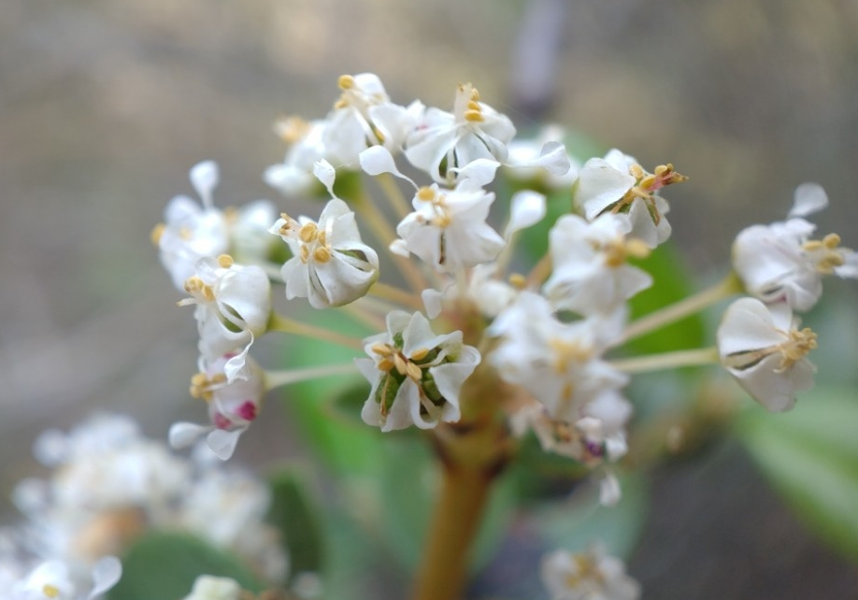
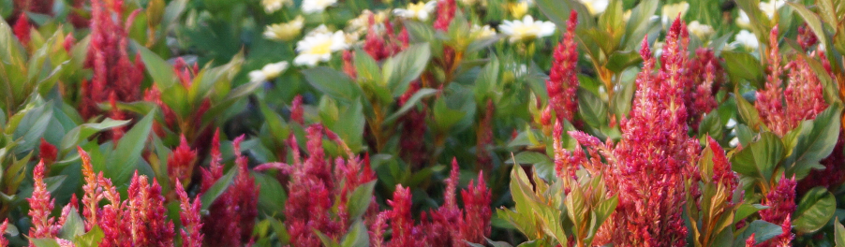
What conservation problems can be addressed?
Real World Applications
Conservation strategies
Harvest strategies
Package
Calculate vital rates (birth, death)
Estimate stage transition probability (projection matrix)
Model
Estimate population growth rate
Estimate extinction risk
Project population growth
Ceanothus ferrisiae
Celosia
Notes:
How can we use this package and modeling approach? Put the modeling effort in context. Why would we want to use this package and approach?
The focus should be on how is this package and approach useful.

Slide 4
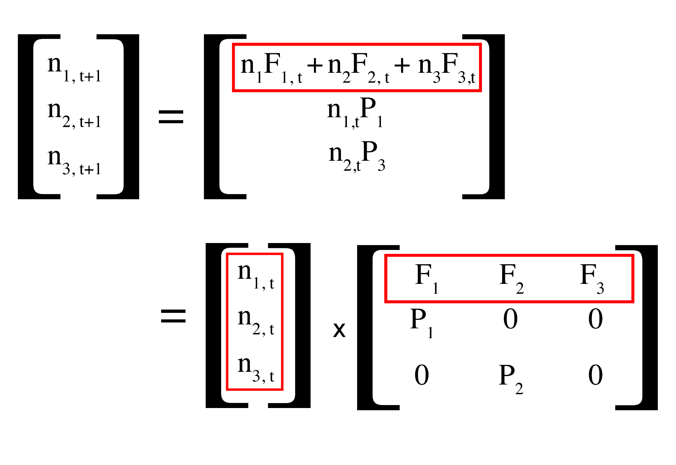
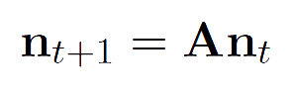
Model Overview
λ = population growth rate
Deterministic Approach
A = population projection matrix
n(t) = population vector at time t
n(t+1) = population vector at time t+1
Utah State University, 2021.
Notes:
Show the model and describe it if possible. There may be many models in a package. Try to be comprehensive, but not overwhelming. If there are many models, show a couple of them. The big thing is to highlight the key features of the model

Slide 5



f_{3,1}= 1.6
f_{1,1}
f_{1,2}
f_{1,3}
p_{3,2}=
0.5
p_{2,1}
p_{2,2}
p_{2,3}
p_{2,1}= 0.5
p_{3,1}
p_{3,2}
p_{3,3}
Vegetative
Seedling
p_{2,2}=
0.5
Reproductive
p_{3,3}= 0.67
0
0
1.6
A =
f = fecundity
p = probability to transition
0.5
0.5
0
0
0.5
0.67
Notes:
Show the model and describe it if possible. There may be many models in a package. Try to be comprehensive, but not overwhelming. If there are many models, show a couple of them. The big thing is to highlight the key features of the model

Slide 6
What type of data is needed?
Census Data
Identifier of individuals
Survey year
Life stage or Age class
Number of offspring produced by each individual
NOTE:
For our learning example, we will use test.census data, which contains 3 years of census data for a hypothetical plant with 3 stage classes
Notes:
One of the most significant modeling limitations is having the right type of data. Do you need observations of N through time, lat/long information, or parameters of life history? Explain all the data needed to use the package.
lambda:
A: A projection matrix
deterministic (relies on nt+1 = A(nt) eqn):
pop.projection(matrix, initial stage vector, number of iterations)
stochastic:

Slide 7
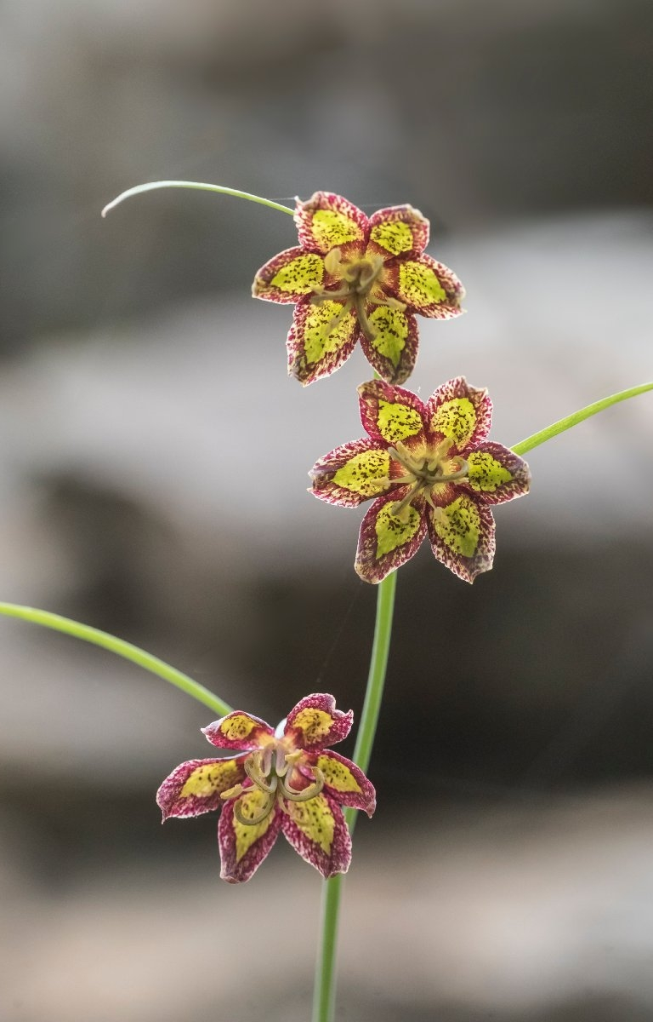
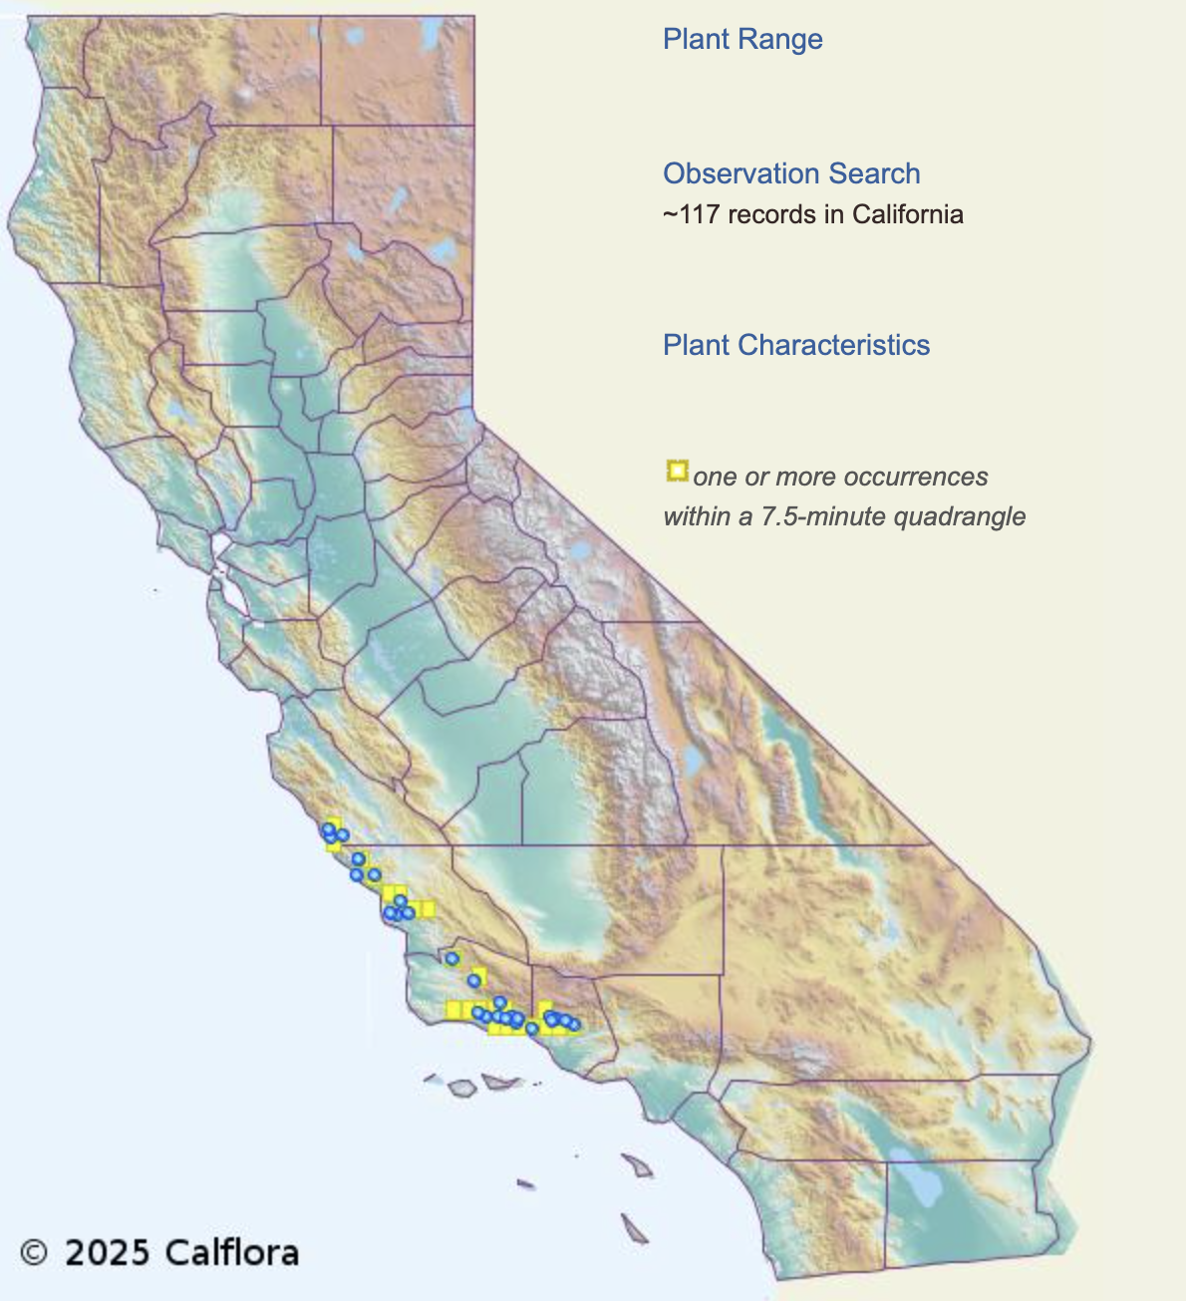
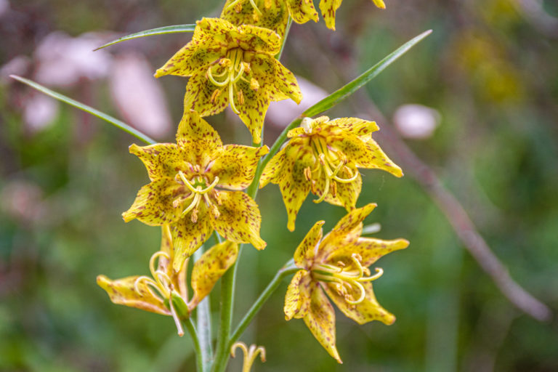
Ojai Fritillary (Fritillaria ojaiensis)
Rare species, native and endemic to California
Listed as a sensitive species by USFS
Common threats: road and trail maintenance; recreational activity; construction and maintenance of fuel breaks
As of this year, ~117 recorded observations
Problem:
What is the population growth rate for Ojai Fritillary?
Ojai Fritillary. Los Padres ForestWatch. (2019, May 30). https://lpfw.org/our-region/wildlife/ojai-fritillary/
Fritillaria ojaiensis. The Calflora Database. (2025). https://www.calflora.org/app/taxon?crn=3638
Notes:
Use as many of these slides as needed, but set up a population model. You may use an example problem in a vignette, published paper, or existing effort. Just make sure to cite it!
Try to connect with your colleagues. Use problems relevant to us!

Slide 8
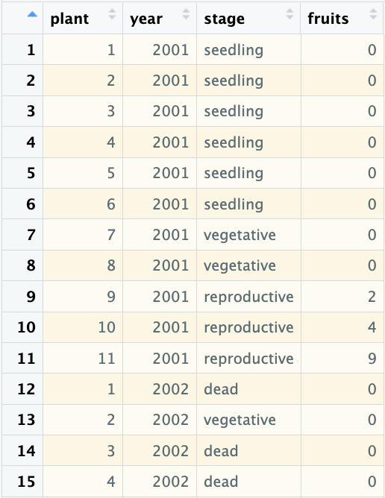
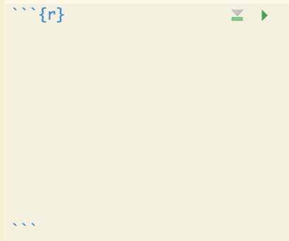
1. Create Stage-Fate Dataframe
REMEMBER:
tidy data
# load package
library(popbio)
# load data
data <- test.census
Notes:
Show how it works. Use as many slides as needed.

Slide 9
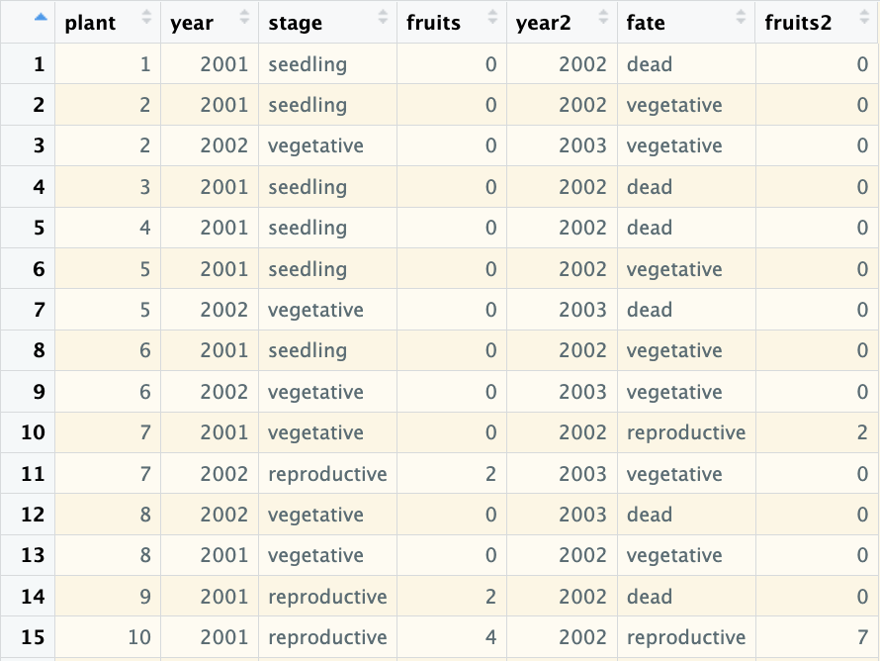
1. Create Stage-Fate Dataframe
# create the stage-fate dataframe
trans <- subset(merge(data, data, by = “plant”, sort = FALSE), year.x == year.y - 1)
# rename rows to improve clarity
rownames(trans) <- 1:nrow(trans)
# rename columns to improve clarity
colnames(trans)[2:7] <- c(“year”, “stage”, “fruits”, “year2”, “fate”, “fruits2”)
Notes:
Stage-fate dataframe links observation of an individual from one time point with its fate in the following time point.
first point reads: create a new dataframe and match data collected in one year to data collected the next year for each individual

Slide 10
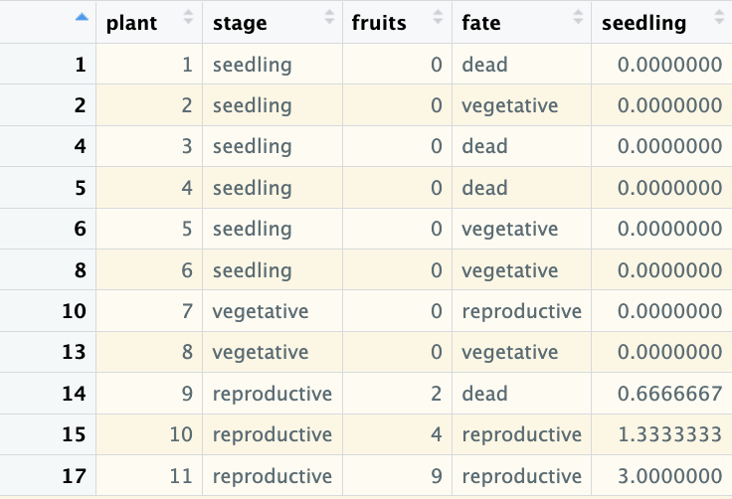
2. Calculate Fertility Rates
FINDING 2001 FERTILITY RATES
# subset the data from 2001
trans01 <- subset(trans, year == 2001, c(plant, stage, fruits, fate))
# count the number of seedlings observed in the following year (2002)
seedlings02 <- nrow(subset(trans, year == 2002 & stage == “seedling”))
# calculate the relative fertility rate of each plant and store it in a new “seedling” column
trans01$seedling <- trans01$fruits/sum(trans01$fruits) * seedlings02
Notes:
Fertility rates are necessary to determine reproductive success of each individual and to produce a projection matrix. For situations when we lack information on the direct number of offspring produced (like this example), a relative fertility rate can be used instead.
Relative fertility rate - # of offspring produced by individuals in a population relative to the number that could be produced by the population

Slide 11
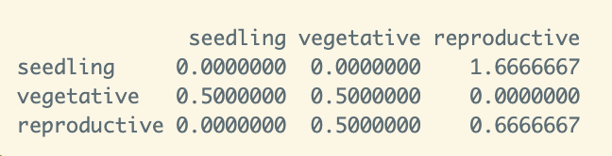
3. Create Leslie Projection Matrix
Building Projection Matrix using 2001 Fertility Rate
# assign different life stages
stages <- c(“seedling”, “vegetative”, “reproductive”)
# create population projection matrix
A01 <- projection.matrix(trans01, sort = stages)
Notes:
Show how it works. Use as many slides as needed.

Slide 12
3. Interpreting Leslie Projection Matrix
Seedling
Vegetative
Reproductive
Notes:
Show how it works. Use as many slides as needed.

Slide 13
3. Interpreting Leslie Projection Matrix
1.67
0.5
0.5
Seedling
Vegetative
0.5
Reproductive
0.67
Notes:
Show how it works. Use as many slides as needed.

Slide 14
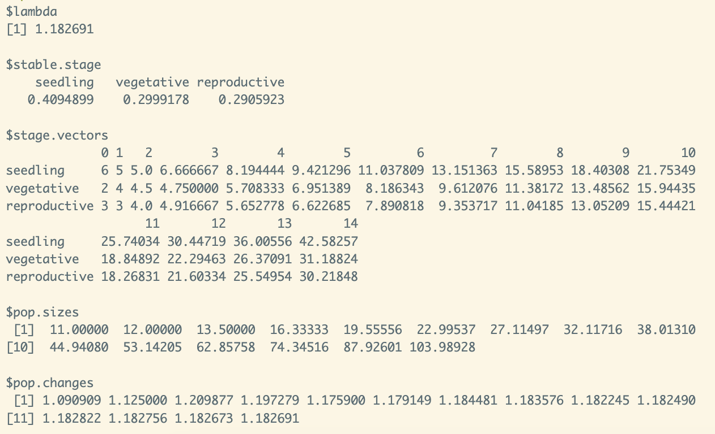
4. Find Population Growth Rate
REMEMBER:
Assumes density-independent population growth, constant vital rates and environment
# assign starting population distribution
n01 <- c(6, 2, 3)
# project population growth
p01 <- pop.projection(A01, n01, 15)
HINT FOR PORTFOLIO ASSIGNMENT:
lambda(INSERT PROJECTION MATRIX)
is another (quick) way to find deterministic population growth rate
Notes:
lambda = population growth rate
stable.stage = in stable equilibrium, the proportion of each life stage present
stage.vectors = distribution of individuals in each life stage over each projected year
pop.size = total population size of each projected year

Slide 15
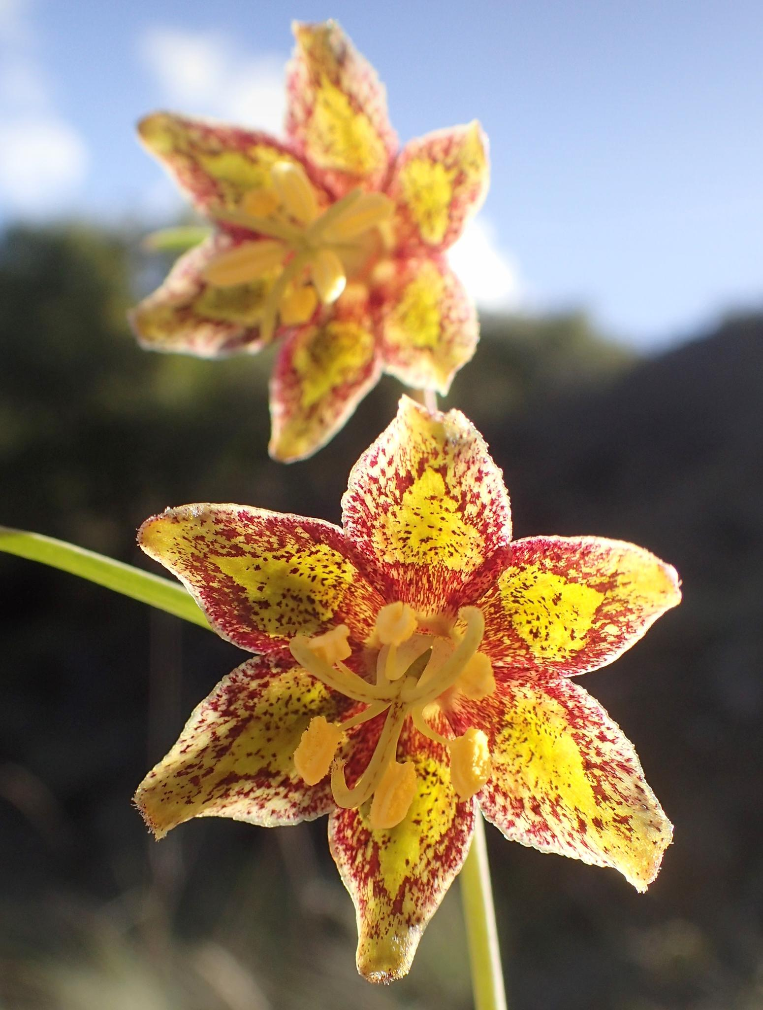
YOUR TURN TO PRACTICE
How would population growth rate change if it was calculated using the 2002 fertility rate?
Workflow hint
Find 2002 relative fertility rate
Build projection matrix with the 2002 fertility rate
Find the new population growth rate. Assume the same starting population (6 seedlings, 2 vegetative, and 3 reproductive individuals) projected over 15 years.

Slide 16
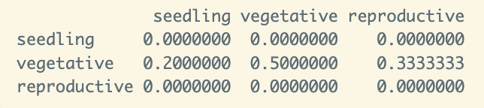
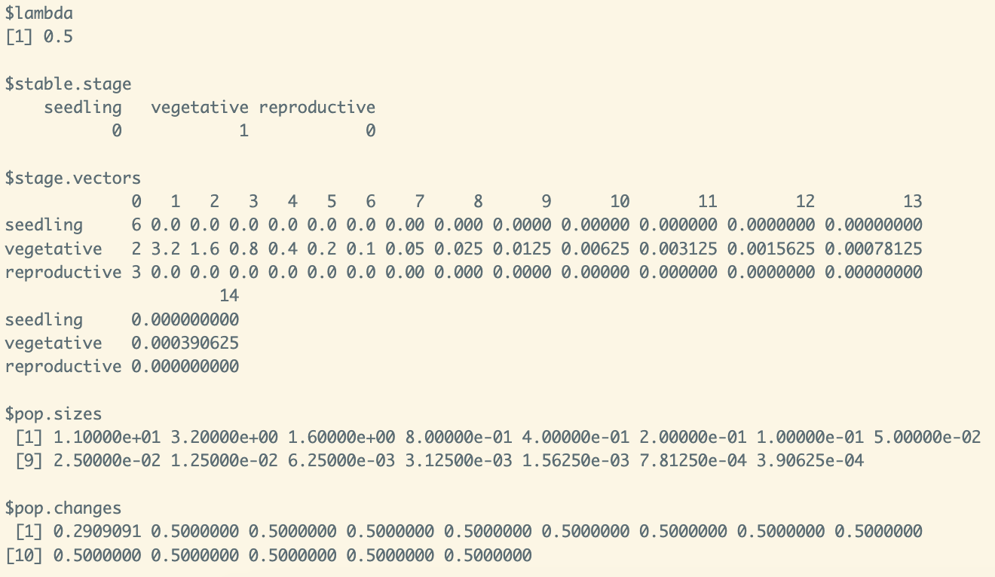
CONFIRM YOUR ANSWERS
How does population growth rate change if it was calculated using the 2002 fertility rate?
2002 rate (0.50) < 2001 rate (1.18)
With this method, growth rate and projections are based on the population dynamics of a singular year.
Notes:
population growth rate changes (decreases by almost half)
alludes to how this method of population projection may result in dramatically different interpretations, so be aware of the data you’re working with

Slide 17
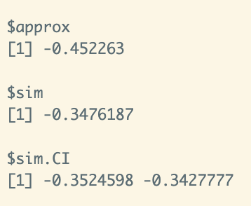
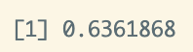
5. Find Stochastic Population Growth Rate
REMEMBER:
Log stochastic growth rate
Assumes variable vital rates and environment
To calculate stochastic growth rate, we need at least two projection matrices
# compile all projection matrices in one list
matrices <- list(A01,A02)
names(matrices) <- c(“A01”, “A02”)
# find stochastic growth rate
sgr<- stoch.growth.rate(matrices, verbose = FALSE)
exp(sgr$approx)
Notes:
Show how it works. Use as many slides as needed.

Slide 18
Advantages & Disadvantages
Ease of use and reproducibility
Standardizes basic methods for demographic analysis
Wide array of available functions for creating and analyzing projection matrices
Requires a large amount of statistical and mathematical analysis
Limited number of preloaded data, making it difficult for comparative analysis
Notes:
What makes this approach or package so useful for conservation and/or data analysis?
What are the problems with the package or approach? You may want to look into the literature about any professional criticisms.

Slide 19
Resources
Package
Application
DOI: 10.32614/CRAN.package.popbio
Stubben, C., Milligan, B., & Maintainer, P. (2020). Package “popbio.” https://cran.r-project.org/web/packages/popbio/popbio.pdf
Stubben, C., & Milligan, B. (2007). Estimating and Analyzing Demographic Models Using the popbio Package in R. Journal of Statistical Software, 22(11), 1–23. https://doi.org/10.18637/jss.v022.i11
Tobias, V. D., Chen, E., Hobbs, J., Eakin, M., & Detwiler, S. (2023). Informing extinction risk: Summarizing population viability through a meta-analysis of multiple long-term monitoring programs for a declining estuarine fish species. Biological Conservation, 288, 110348. https://doi.org/10.1016/j.biocon.2023.110348
Notes:
Provide the CRAN link.
Emphasize any vignettes that you found useful
Is there a methods paper that describes the package? Give the citation.
Are there any applications in the literature you found useful insightful.

Slide 20
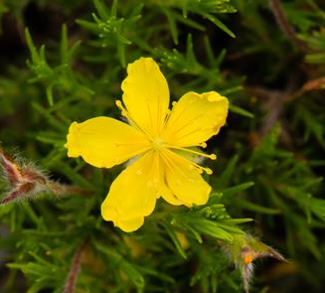
Portfolio Assignment - Hudsonia montana
Native to North Carolina
Federally listed as threatened
Threats: fire suppression, trampling, habitat loss
Using the prepared hudsonia matrices available in popbio, answer the following:
What is the population growth rate for each year of available data (1985-1988)? Use the deterministic approach.
What is the stochastic growth rate?
Compare the growth rates calculated using the two methods. How are they different? Why?
Notes:
Provide 2-3 questions that use the package. Provide suitable data and the answers.

